Slide 1

GI (travel) X-Sell EDA

Slide 3
Key discovery
Notes:
Time Range
Pre-Covid: Jan 2017 - Feb 2020
Covid: Mar 2020 – Jun 2022
Post-Covid Jun 2022 - Now
Channel
Other: Citi and JLT
AXA Direct has an increasing coverage % during covid, yet HSBC still has the highest number of clients who bought new policies during Covid.
Life Agents has reached the top at 2020, during the covid 19, Life Agents have more impact on customers during covid
The travel duration for single trip is higher during covid
The age group with the most number for each channel for each year increased during covid, that means the Age of people going to travel increased during Covid.
Female always tends to buy travel insurance then Male in any case. Females are always more aware of insurance then Male.

Slide 4
Percentage of customers who buy LH after claimed in travel is significantly higher than not claimed in travel. Except for HSBC, maybe due to lack of agent?
Among those travel customers, 83% haven’t bought any LH products.
Generally, more clients are buying L&H through the year according to submit year of LH application, except for 2018 has a slight drop.
Since around 2012, the Age group of first-time-buying-LH has most increased in the age group of 17-30, more young people are gaining more awareness on LH insurance products.
Most people first buy L&H product at the age 18,22-26,29-30
The average annual premium of traditional life(pink) has increased drastically from 2018.
Medical(red) increased while critical illness(blue) decreased. Seems more ppl are buying medical instead of CI.
The number of policy of medical product is the largest while traditional life is the most profitable product compare both Total .
Age group of 51-60 has pay more premium in average in 2020, and return to previous level afterwards.

Slide 5
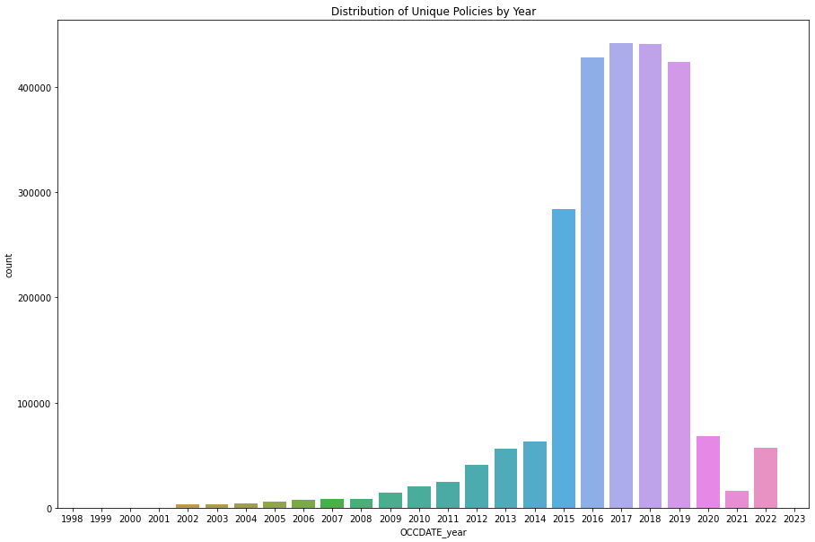
Number of new policies at that year
This graph shows new policies sold at that year
GI travel data was extracted at Oct 2022, yet there are some 2023 data as some clients purchase insurance far before travel date.

Slide 6
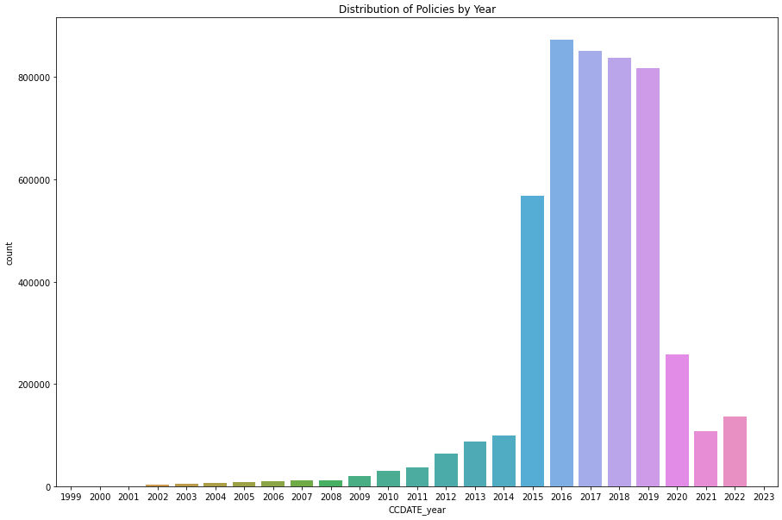
Number of inforce policies at that year
There’s a drop after 2020 and get to the lowest point at 2021.

Slide 7
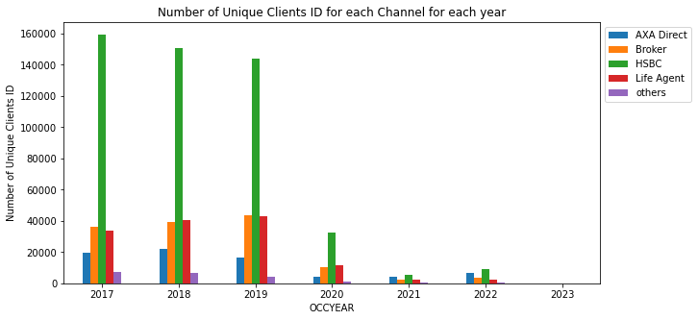
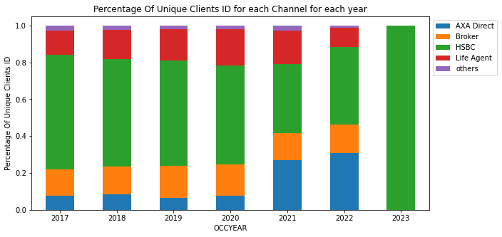
Number of Clients bought new policies at that year
Kelvin Editing
Change to table show overall unique client count
There is a huge drop in 2020
AXA Direct has an increasing coverage % during 2021-2022, yet HSBC still has the highest number of clients who bought new policies between 2020-2022.
Notes:
Channel
Other: Citi and JLT

Slide 8
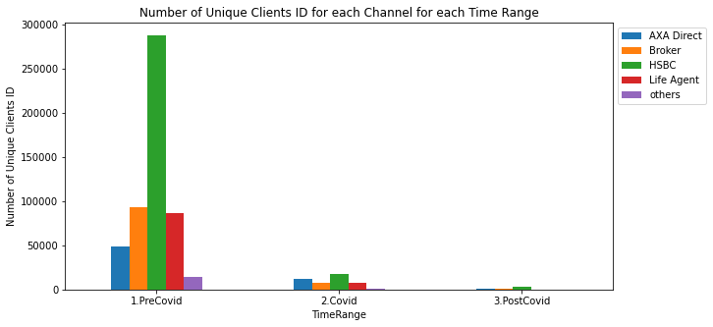
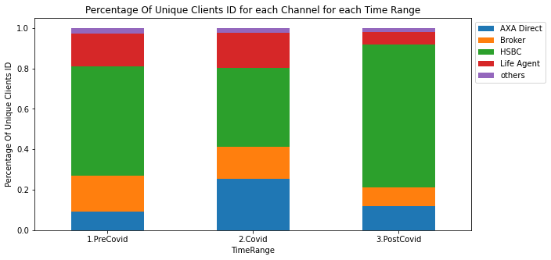
Kelvin Editing
Change to table show overall unique client count
Number of Clients bought new policies at different period
Notes:
Time Range
Pre-Covid: Jan 2017 - Feb 2020
Covid: Mar 2020 – Jun 2022
Post-Covid Jun 2022 - Now
Channel
Other: Citi and JLT

Slide 9
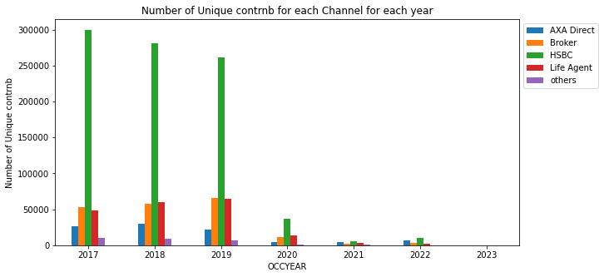
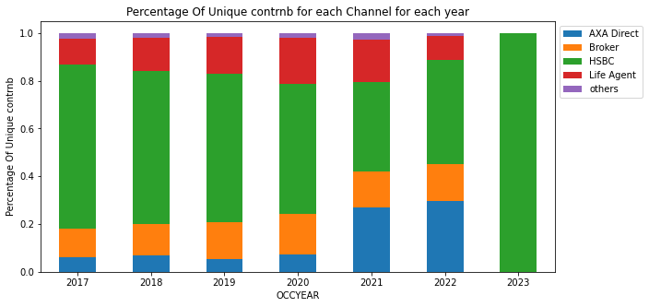
Kelvin Edited
Number of new policies bought at that year
There is a huge drop in 2020
AXA Direct has an increasing coverage % during 2021-2022, yet HSBC still has the highest number of clients who bought new policies between 2020-2022.
Notes:
Channel
Other: Citi and JLT

Slide 10
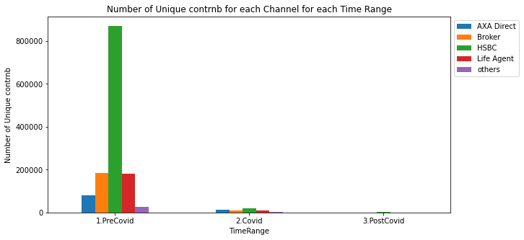
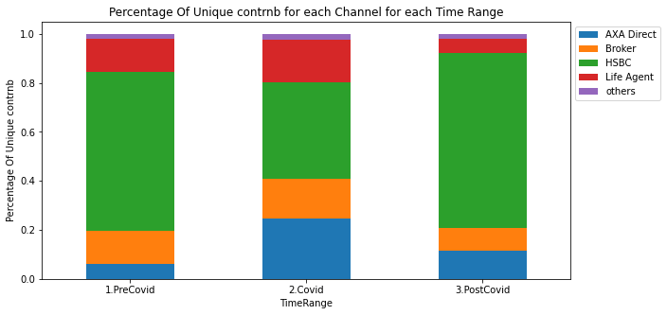
Kelvin Edited
Number of new policies bought at that year
There is a huge drop during Covid
AXA Direct has an increasing coverage % during covid, yet HSBC still has the highest number of clients who bought new policies during Covid.
Notes:
Time Range
Pre-Covid: Jan 2017 - Feb 2020
Covid: Mar 2020 – Jun 2022
Post-Covid Jun 2022 - Now
Channel
Other: Citi and JLT

Slide 11
New Policies by channel per year
HSBC has decreased it’s market share
Direct sells has increased its market share
Broker’s percentage has no significant change
Life Agents has reached the top at 2020, during the covid 19
Life Agents have more impact on customers during covid

Slide 12
Product Distribution by

Slide 13
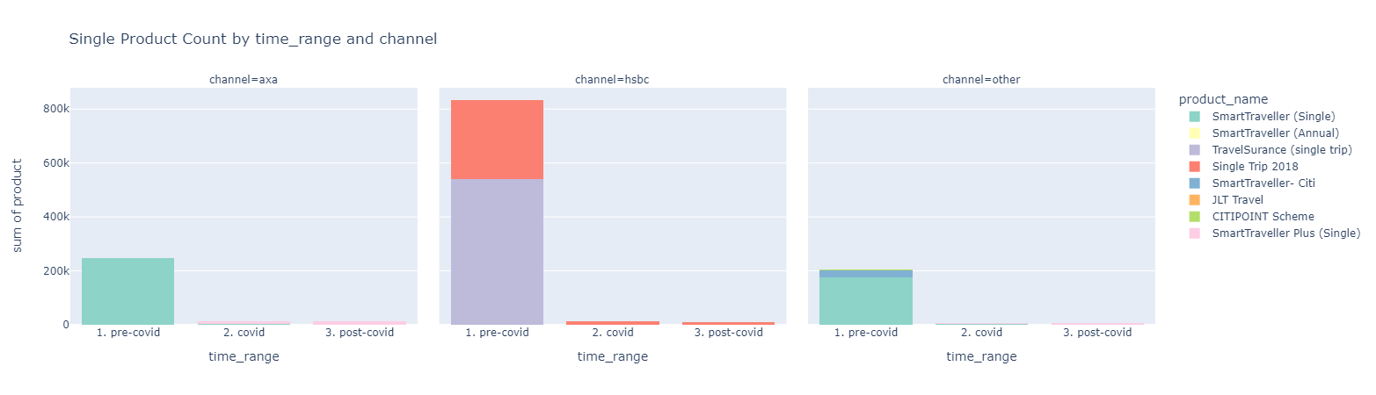
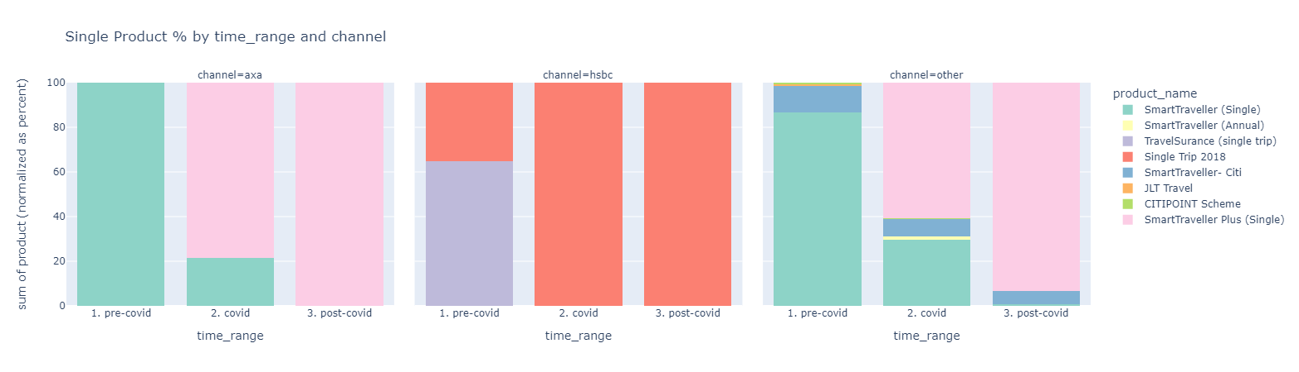
Single Trip Product Distribution by period and channel
Huge drop in number of policies after covid.
For AXA and other channels, most clients shift to SmartTraveller Plus after covid happens
Notes:
SmartTraveller (Annual) should not be included here
Time range:
Pre-Covid: Jan 2017 - Feb 2020
Covid: Mar 2020 – Jun 2022
Post-Covid Jun 2022 - Now
Channel:
Other: LAB, Citi, JLT

Slide 14
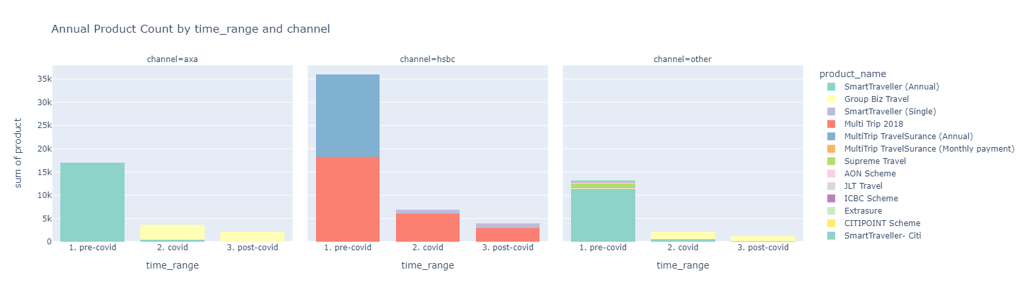

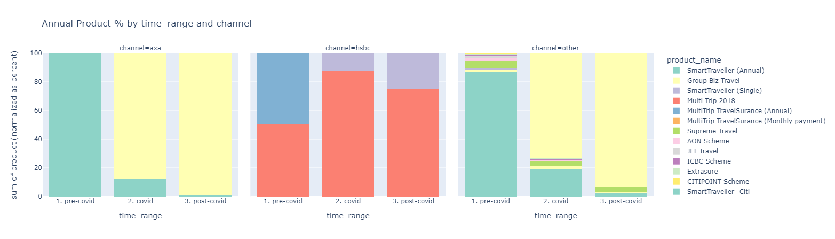
Annual Trip Product Distribution by period and channel
Compared to single trip, the percentage drop in number of annual policies after covid is smaller.
Similarly, for AXA and other channels, most clients shift to SmartTraveller Plus after covid happens.
For HSBC, there is an increase trend in student insurance.
Overseas StudySurance
Overseas StudySurance
SmartTraveller
Plus (Annual)
SmartTraveller
Plus (Annual)
SmartTraveller
Plus (Annual)
SmartTraveller
Plus (Annual)
Notes:
SmartTraveller (Single) should not be included here
Time range:
Pre-Covid: Jan 2017 - Feb 2020
Covid: Mar 2020 – Jun 2022
Post-Covid Jun 2022 - Now
Channel:
Other: LAB, Citi, JLT

Slide 15
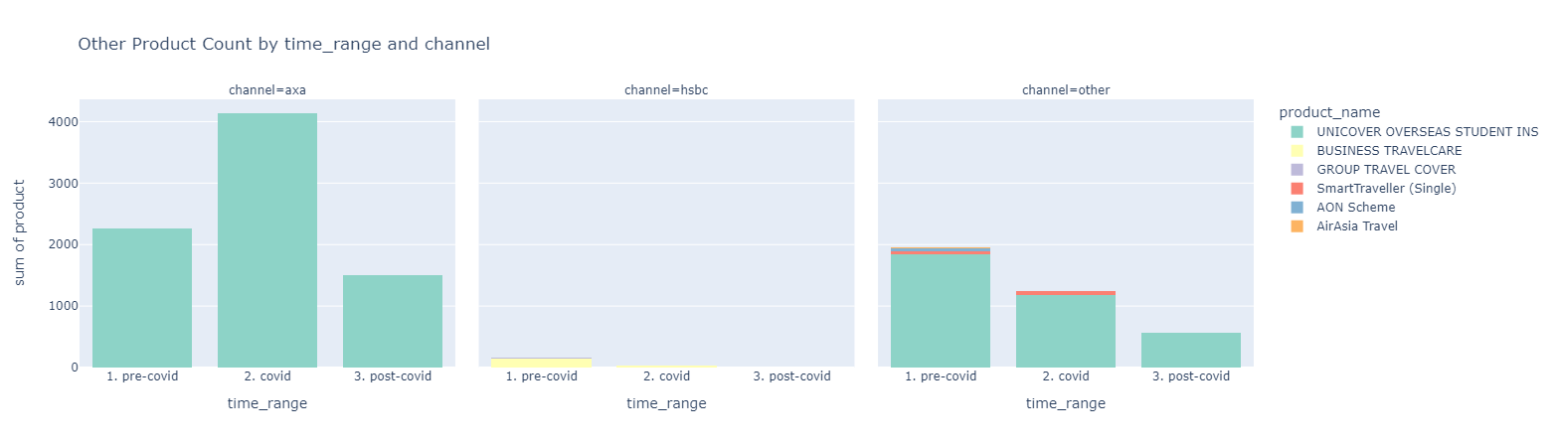
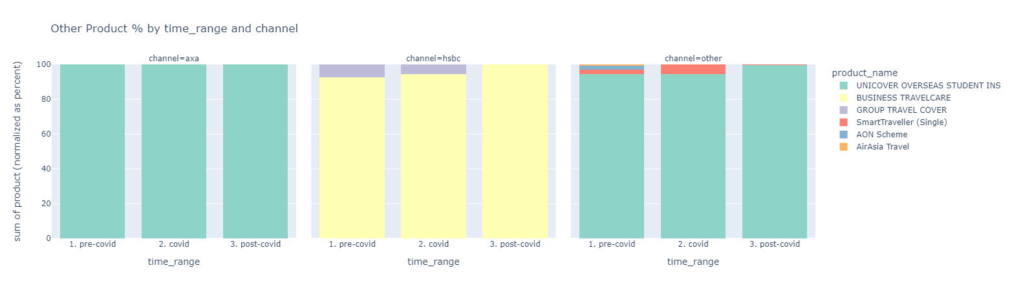
Other Trip Product Distribution by period and channel
For AXA, there is a double-up of student insurance during covid.
For other channels, the trend of student insurance is the opposite (downward trend)
Notes:
SmartTraveller (Single) should not be included here
Time range:
Pre-Covid: Jan 2017 - Feb 2020
Covid: Mar 2020 – Jun 2022
Post-Covid Jun 2022 - Now
Channel:
Other: LAB, Citi, JLT

Slide 16
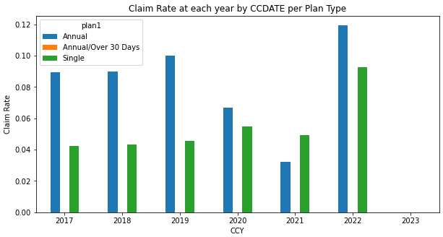
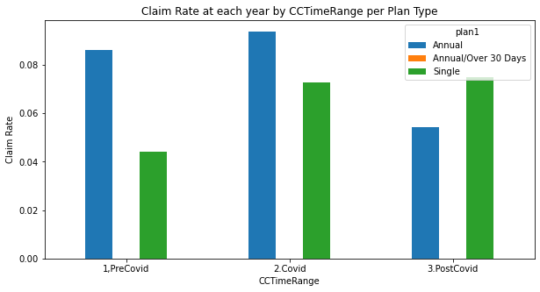
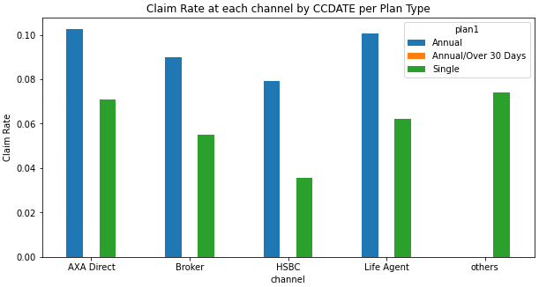
Kelvin: Separate Single/Annual in different graphs, use line chart to show claim rate
By channel by year

Slide 17
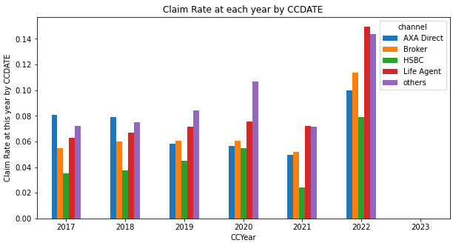
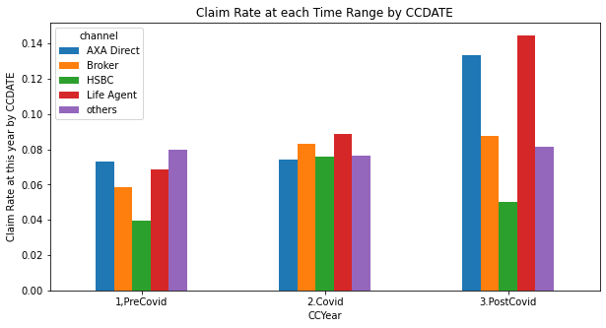
←Single one pic/ annual one pic
Line graph

Slide 18
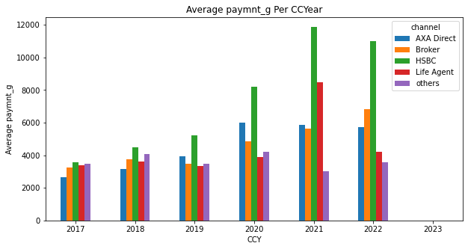
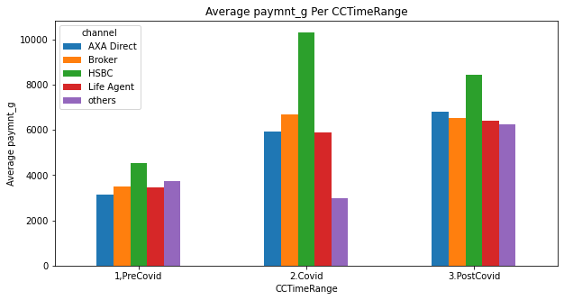
Claim Payment
Kelvin: Separate Single/Annual in different graphs, use line chart to show claim amt
By channel by year
Avg payment for claim increased after entering covid

Slide 19
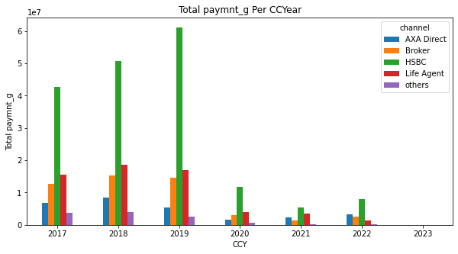
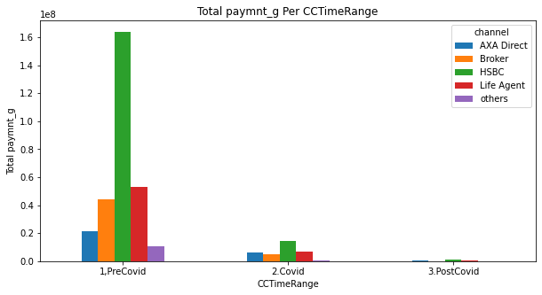
Claim Payment

Slide 20
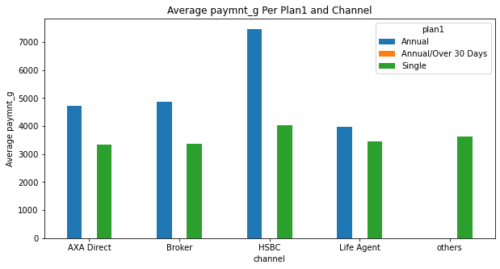
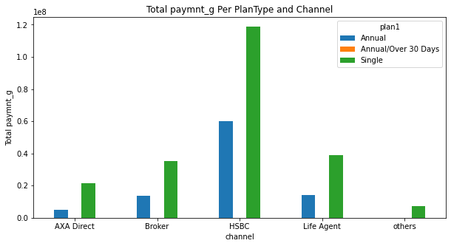

Slide 21
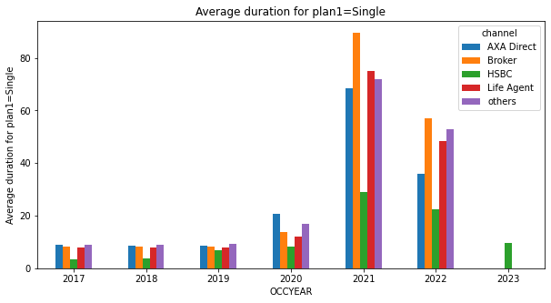
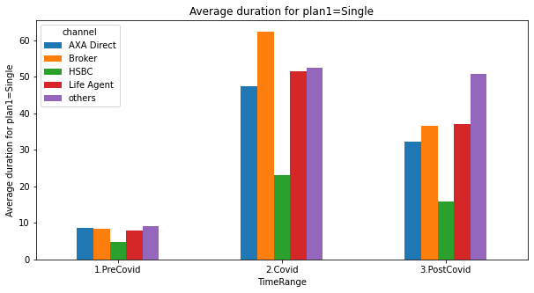
Travel Duration
The travel duration for single trip is the highest during covid

Slide 22
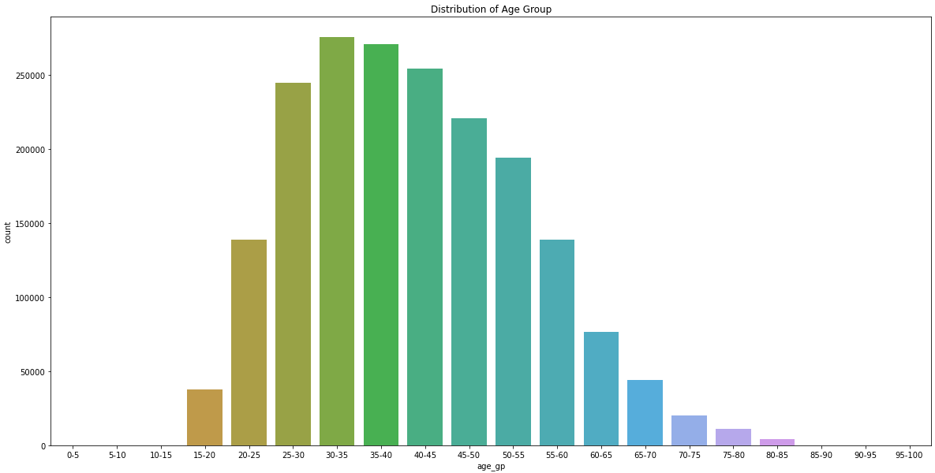
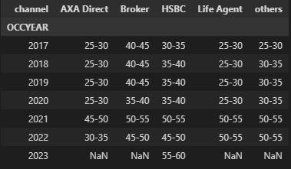
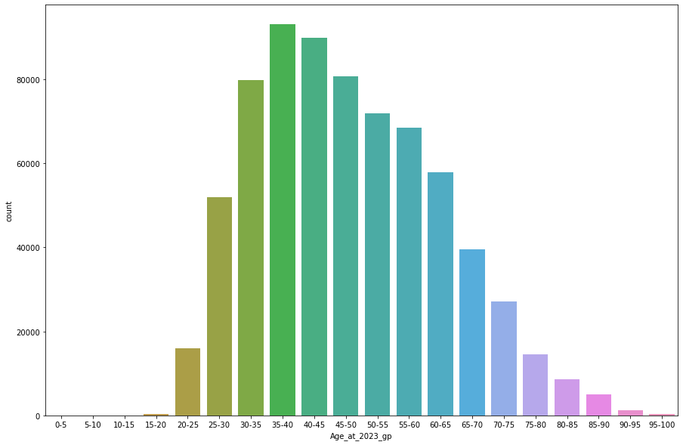
Age Distribution
The age_gp with the most number for each channel for each year

Slide 23
The age_gp with the most number for each channel for each year

Slide 24
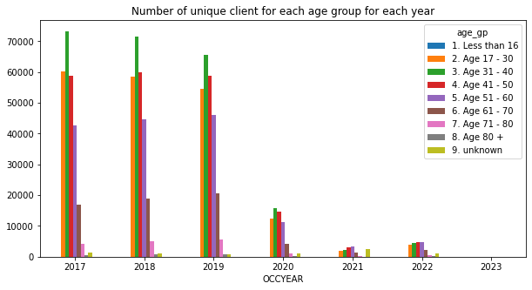
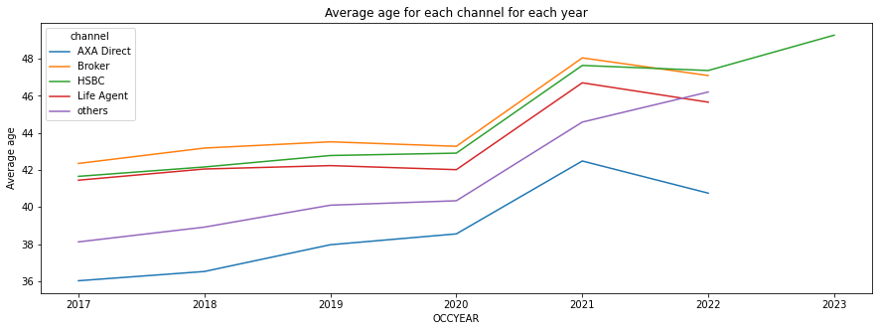

Slide 25
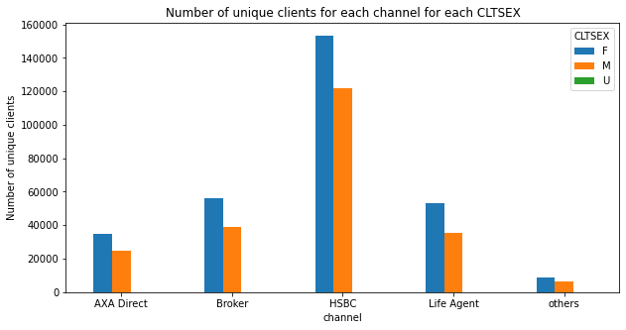
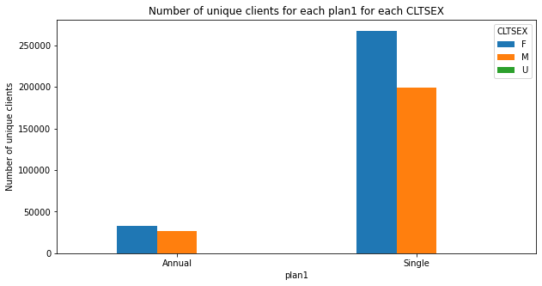
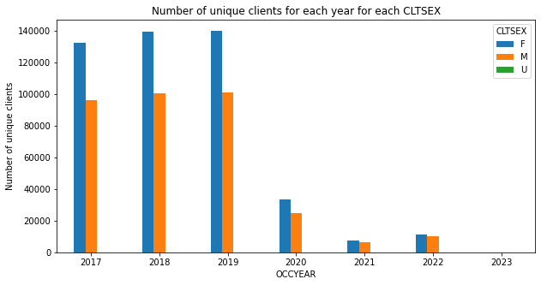
Gender
Female always tends to buy travel insurance then Male
Overall Gender Percentage:
F 321073 47%
M 251182 36%
Nan 115156 17%
U 980 0.1%

Slide 26
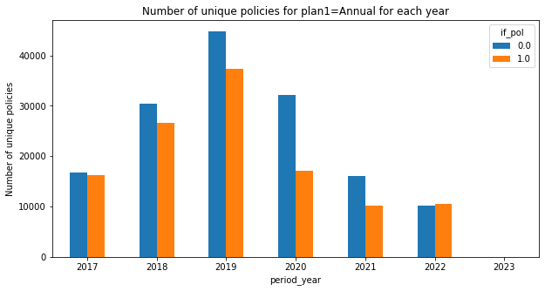
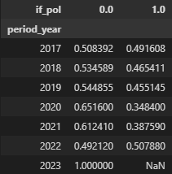
Lapsed/Inforce Count and Ratio for Annual Plan
The inforce ratio get’s higher then lapsed ratio in 2022

Slide 27
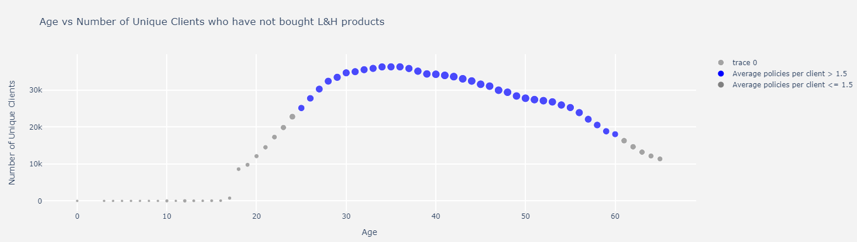

Slide 28
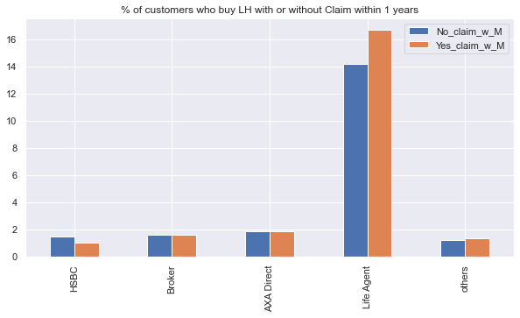
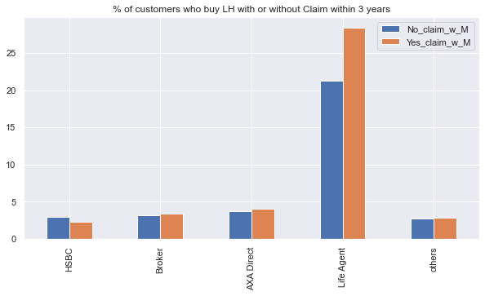
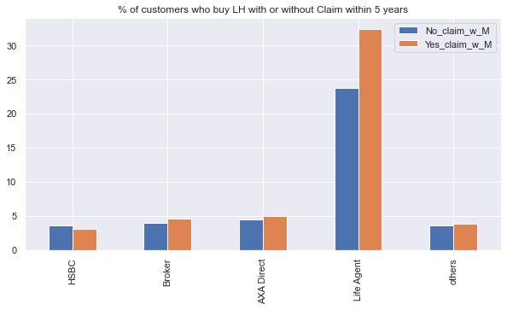
Claim LH effect
Blue= (T+~C+M)/(T+~C)
Orange=(T+C+M)/(T+C)

Slide 29
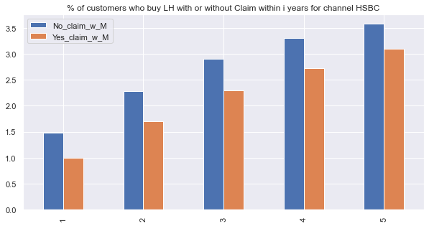
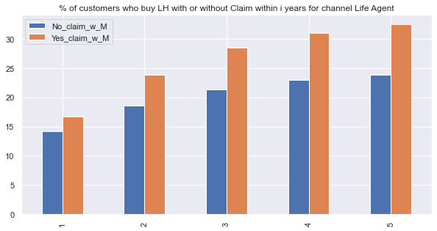
HSBC vs Life Agent

Slide 30
Frequency for travel customers
 |  | 1. PreCovid | 2.Covid | 3.PostCovid
Bought at least 1 time Number_unique_contrnb>=1 | Single | 471338 | 30565 | 3743
 | Annual | 53907 | 11282 | 1076
Bought at least 2 time | Single | 237906 | 3398 | 261
 | Annual | 8662 | 828 | 38
bought >=3 time | Single | 151874 | 620 | 38
 | Annual | 1348 | 99 | 5

Slide 31
Unique Client Count of bought LH or not
has_bought_LH | count | %
FALSE | 441035 | 83
TRUE | 88232 | 17
We Have 83% potential customers!!!!

Slide 32
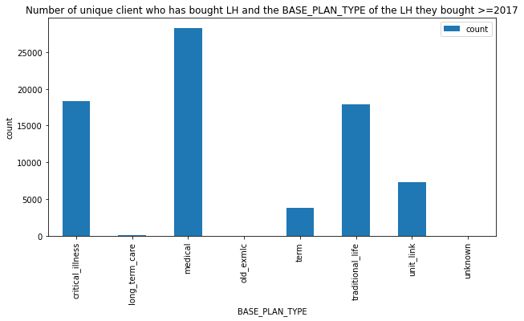
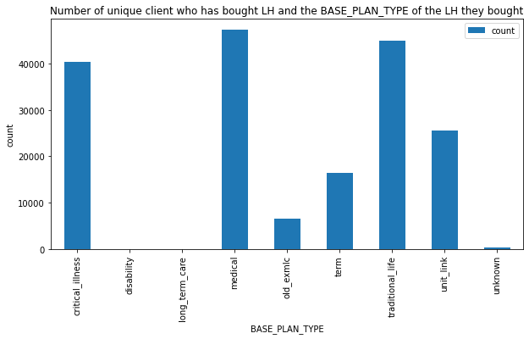

Slide 33
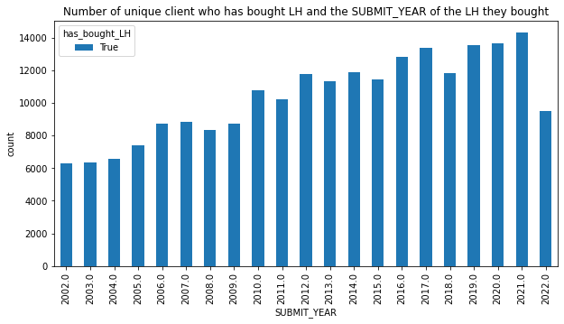
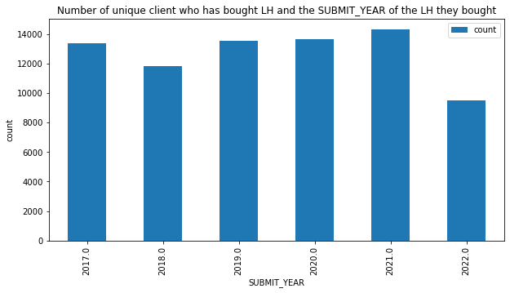

Slide 34
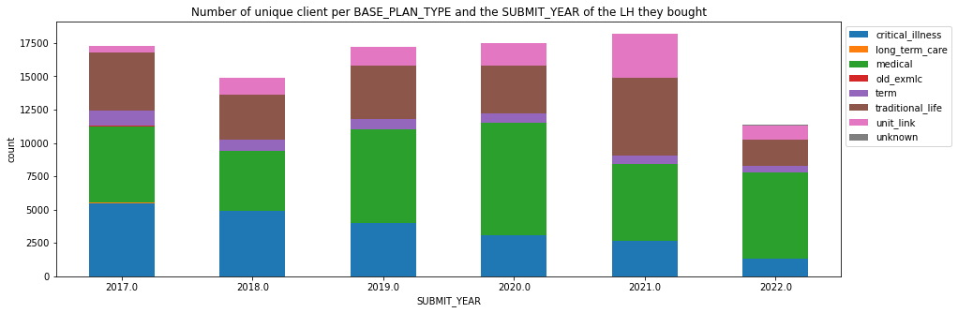

The number of customers buying medical(green) line increased in contrast to other products.
At 2021, more people are buying traditional life(brown).

Slide 35


Most people bought annual trip at 2021
Most travel duration is 4-5 days

Slide 36


First – time –buying –LH-age group distribution.
Since around 2012, the Age group of first-time-buying-LH has most increased in the age group of 17-30, more young people are gaining more awareness on LH insurance products.

Slide 37


Distribution of each unique client’s age when they bought LH for the first time.
Most people first buy L&H product at the age
18
22-26
29-30

Slide 38

With LH Gender Ratio
Females are always more aware of insurance then Male.

Slide 39


Avg premium per year per plan
The average annual premium of traditional life(pink) has increased drastically from 2018.

Slide 40


Total premium per year per type
Total prem of traditional life(pink) has increased from 2018 as well.
Medical(red) increased while critical illness(blue) decreased.
Seems more ppl are buying medical instead of CI.

Slide 41

Total Annual premium VS Number of unique policy number Per year Per Plan Type
The number of policy of medical product is the largest while traditional life is the most profitable product compare both Total .

Slide 42



Premium per age_gp per plan
Term and traditional life are more popular
Old medic is the most profitable product, especially among old people
Traditional life’s profitability is similar in different age-range.

Slide 43


Avg premium per year per age group
Age group of 51-60 has pay more in average in 2020, and return to previous level afterwards.
Age group of 60-61 has increased avg premium at 2019 only.

Slide 44


2019:61-70
2020:51-60

Slide 46
Frequency for Travel + LH Customer
FOR T+LH CUSTOMER |  | 1. PreCovid | 2.Covid | 3.PostCovid
Bought at least 1 time Number_unique_contrnb>=1 | Single | 78576 | 4788 | 393
 | Annual | 11057 | 1626 | 118
Bought at least 2 time | Single | 43718 | 524 | 15
 | Annual | 2269 | 126 | 5
bought >=3 time | Single | 28571 | 79 | 2
 | Annual | 397 | 10 | 1

Slide 47
Key discovery

Slide 48
Knowledge Points
Column ‘plan 1’ is indicating single/annual trip
paymnt_g is being used, not paymnt_n(told by Travel Team)
Use If_pol + period to check if the contract is inforce in that year
CCDATE: renew date , OCCDATE: the date when first buy the policy
DUMMY_ID=['unknown','A123456','F123456’](IDs that I think is not real)
DATREP in claimbase is date of reporting the accident.
There’s some client numbers from basestat are not in cient_base, so I decided to drop all those rows before analysing.
rscd_des in claimbase is the claim type, medical/lost iphone etc

Slide 49
Mapping that I used:
plan1={
'single': 'single',
'Annual': 'Annual',
'Annual/Over 30 Days': 'Annual'
}
modi_channels={
'Banca - HSBC':'HSBC',
'Agents & Broker':'Broker',
'AXA Online Direct':'AXA Direct',
'AXA Offline Direct':'AXA Direct',
'LP':'Life Agent',
'Citi':'others',
'JLT (OSC)': 'others'
}
CURRENCY_CHANGE_RATE_TO_HKD={
"AUD": 6.66,
"CAD": 6.66,
"CHF": 5.71,
"EUR": 8.0,
"USD": 8.0,
"SGD": 5.0,
"NZD":4.44,
"GBP":13.33
}
# generated a new col["ANNUAL_PREM_HKD“] using the CURRENCY_CHANGE_RATE_TO_HKD dict and CURRENCY and ANNUAL_PREM_EXCLUDE_TOPUP_REGULAR
# if CURRENCY is in the dict, then use the value in the dict to multiply ANNUAL_PREM_EXCLUDE_TOPUP_REGULAR
# if CURRENCY is not in the dict, then use 1 to multiply ANNUAL_PREM_EXCLUDE_TOPUP_REGULAR
Base_LH_df["ANNUAL_PREM_HKD"] = Base_LH_df["CURRENCY"].apply(lambda x: CURRENCY_CHANGE_RATE_TO_HKD[x] if x in CURRENCY_CHANGE_RATE_TO_HKD else 1) * Base_LH_df["ANNUAL_PREM_EXCLUDE_TOPUP_REGULAR"]

